Slide 1
Intro to DDL: Data Definition Language
Instructor: Kazi Amit Hasan

Slide 2
Integrity Constraints
Maintain the correctness and consistency of the data by not allowing users to enter incorrect data
Three types of integrity constraints:
Domain constraints:
All attributes come from a defined set of values
Entity integrity
No attribute of a primary key can contain a null value
Referential integrity
A FK must reference a VALID primary key value in the referenced table OR be NULL
These constraints are checked by the DBMS whenever changes are made to the data

Slide 3
MariaDB
XAMPP uses MariaDB, a fork of the MySQL database management system
compatible with MySQL – and I'll probably refer to it as MySQL throughout the course
you will also see "MySQL" listed on the interface to XAMPP

Slide 4
History
IBM Sequel language developed as part of System R project at the IBM San Jose Research Laboratory
Renamed Structured Query Language (SQL)
ANSI and ISO standard SQL:
SQL-86, SQL-89, SQL-92
SQL:1999, SQL:2003, SQL:2008, SQL: 2011, SQL: 2016, SQL: 2019
SQL offered by commercial systems varies
SQL-92 a common basis
Various other features from later standards and proprietary features offered

Slide 5
SQL
Data Definition Language – DDL
Data Manipulation Language - DML

Slide 6
Data Definition Language – DDL
The SQL data-definition language (DDL) allows the specification of information about relations, including:
The schema for each relation.
The domain of each attribute.
Integrity constraints
Other information such as
The set of indices to be maintained for each relations.
Security and authorization information for each relation.
The physical storage structure of each relation on disk.

Slide 7

Creating a Database
A database is a collection of tables (relations).
Before you can create relations, you need to create a database.

Slide 8
Creating Relations
We will specify for each relation:
Relation name
Attributes, domains
Constraints:
Primary key
Foreign key(s)
Null/ not null
There are other things you can specify, but these are the basics

Slide 9
Basic MySQL Domain Types
char(n). Fixed length character string, with user-specified length n
varchar(n). Variable length character strings, with user-specified maximum length n
int. Integer (a finite subset of the integers that is machine-dependent)
decimal(p,d). Fixed point number, with user-specified precision of p digits, with d digits to the right of decimal point.
date. a date in YYYY-MM-DD format
time. stores the time in HH:MM:SS format
enum. a list – used for specifying a value can be “A”, “B” or “C”
And there are many more

Slide 10
Char vs Varchar
char(10) – store “cat” – 7 spaces are appended to the string to make it 10 characters long
varchar(10) – “cat” is stored as 3 characters.

Slide 11
Recommendation
Always use varchar unless you are certain that the data will always be X characters in length.
Saves space in storage– however, causes some minimal overhead in the system
“cat” changed to “elephant” – may need to move the record as it no longer fits in the space that was originally allocated

Slide 12
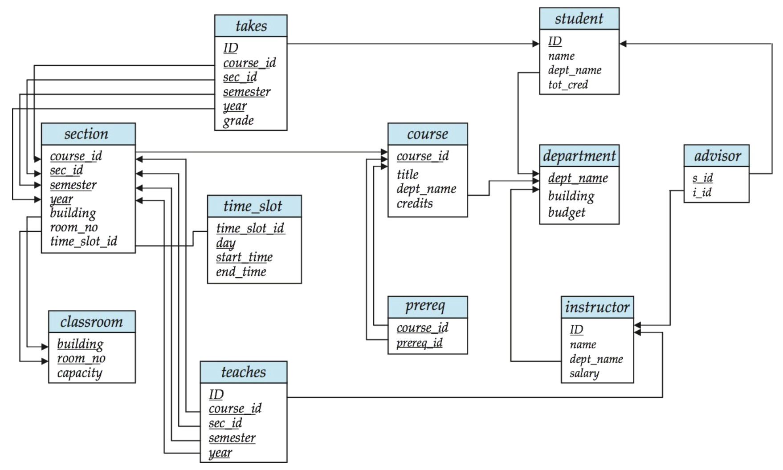
Schema Diagram for University Database

Slide 13
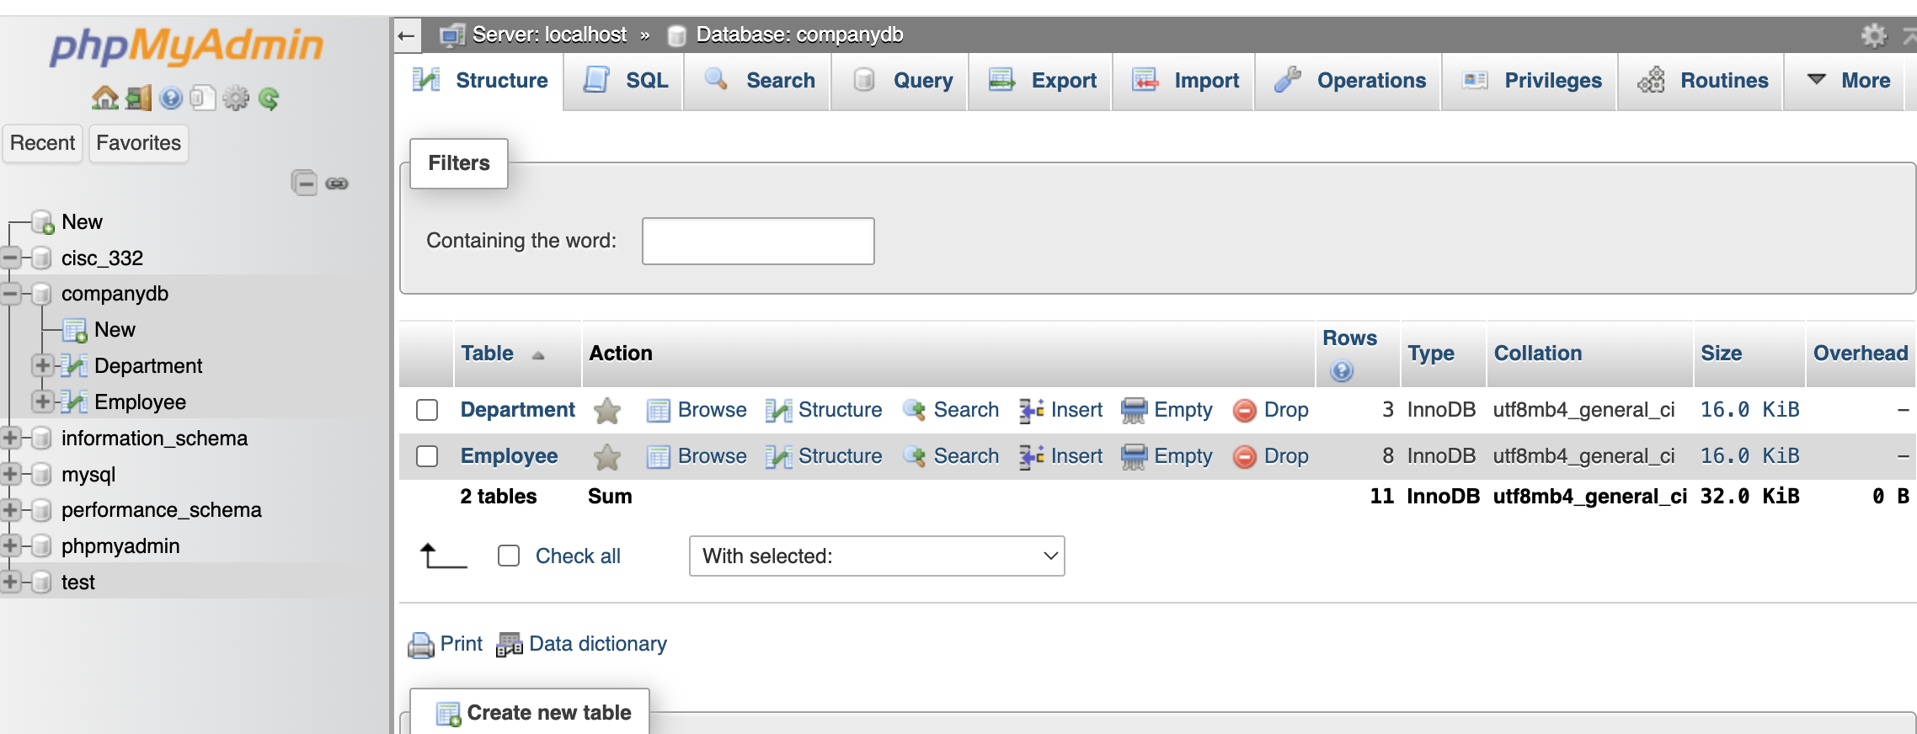
Recommendation
Open XAMPP and try these by yourself

Slide 14
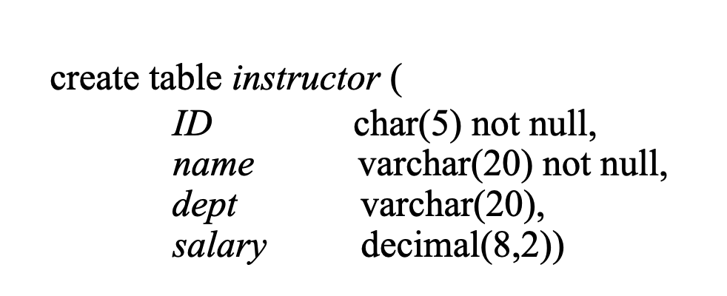
Basic Create Table Statement

Slide 15
Integrity Constraints
Integrity constraints ensure changes made to a database do not result in data inconsistency
Eg:
Not null
Primary key (A)
Foreign key (B) references T(C)

Slide 16
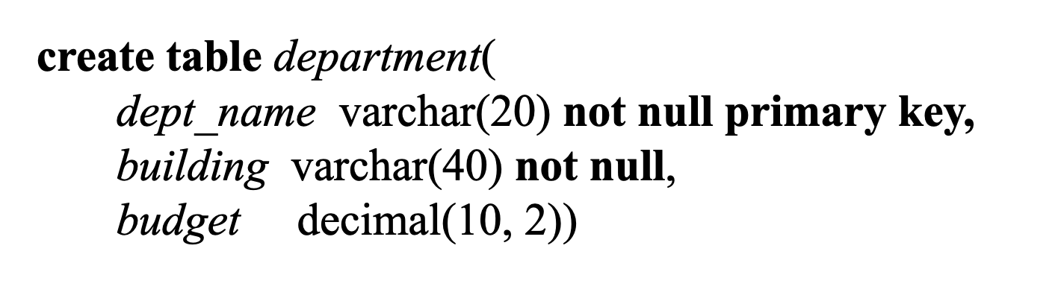
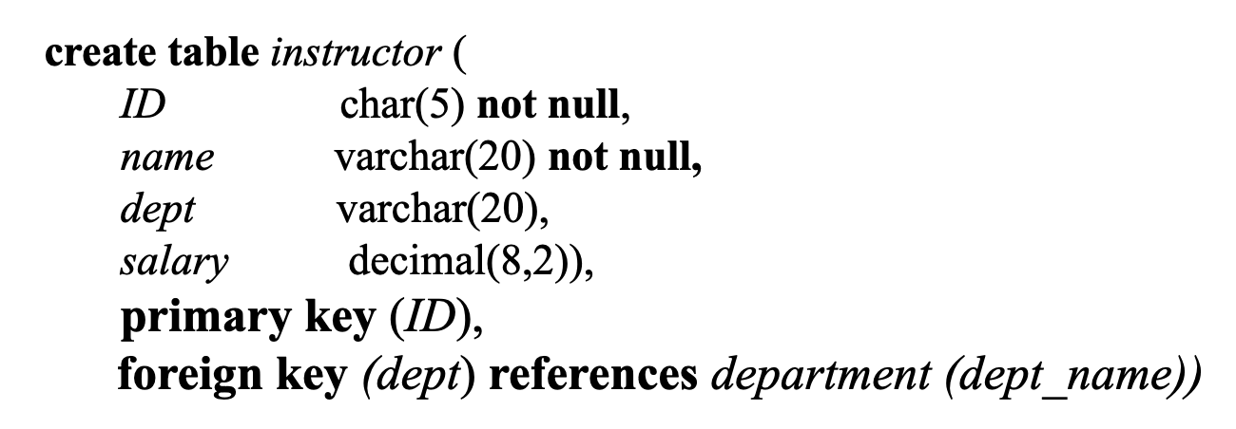
Integrity Constraints

Slide 17
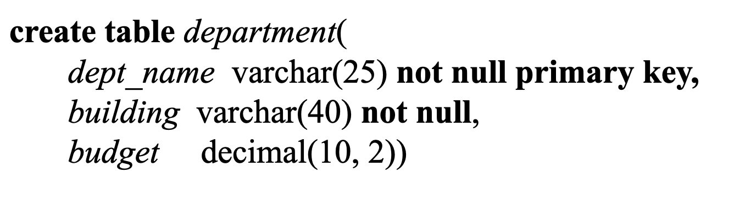
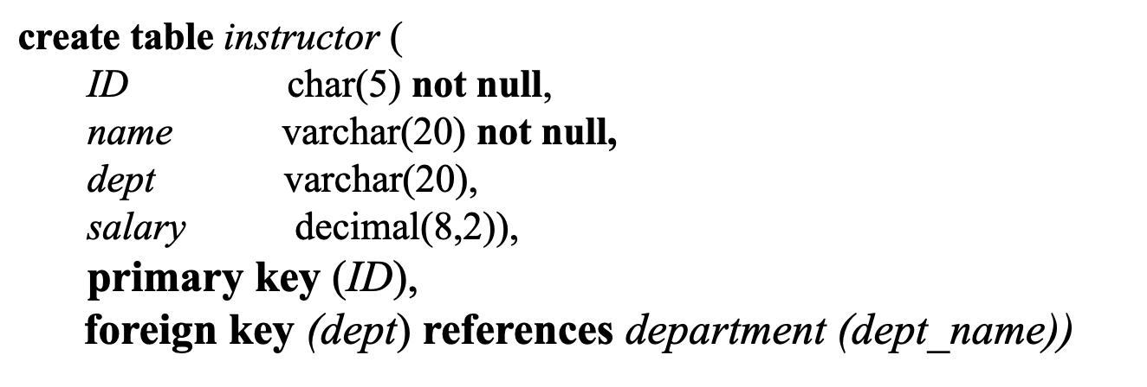
Integrity Constraints – find the error!
Notes:
The data types (and sizes) of the foreign key and the referenced key do NOT match

Slide 18
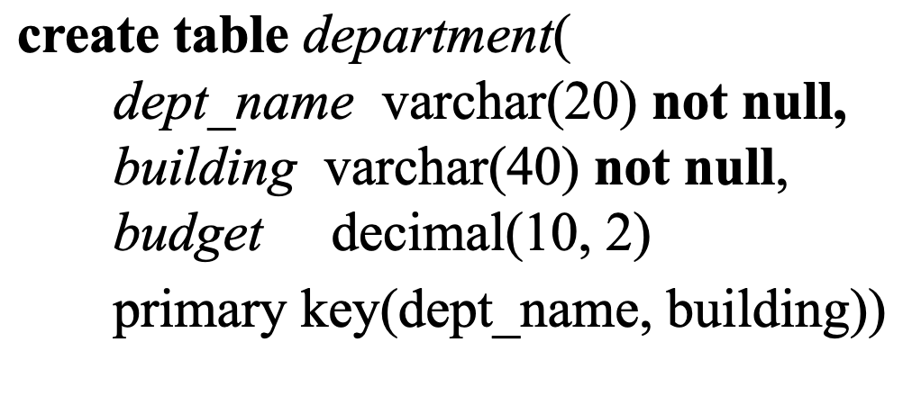
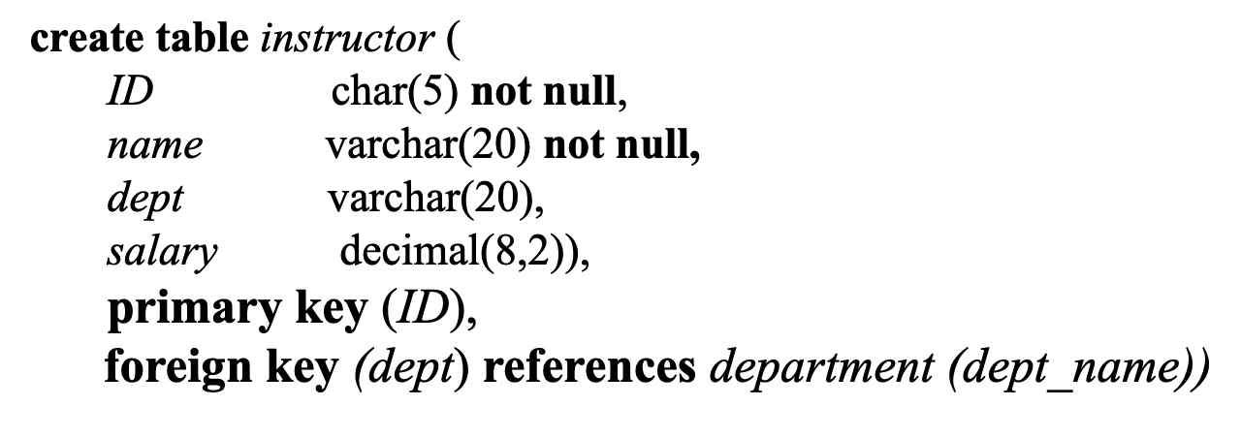
Integrity Constraints – find the error!
Notes:
A foreign key cannot reference only part of a composite primary key unless that part is declared UNIQUE.

Slide 19
Foreign Keys
When defining a foreign key, the referenced table must already exist
if this is not possible, you may need to create the table without the foreign key and use an "alter table" statement to add the foreign key later.

Slide 20
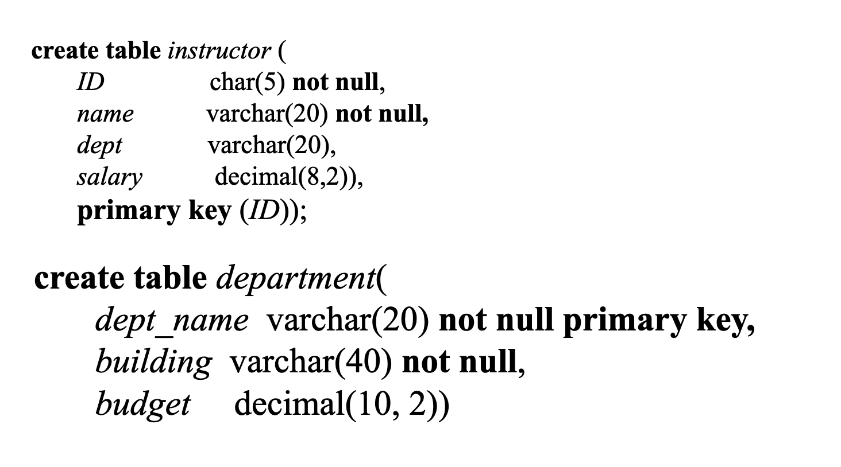
Example
alter table instructor add foreign key (dept) references department (dept_name))

Slide 21
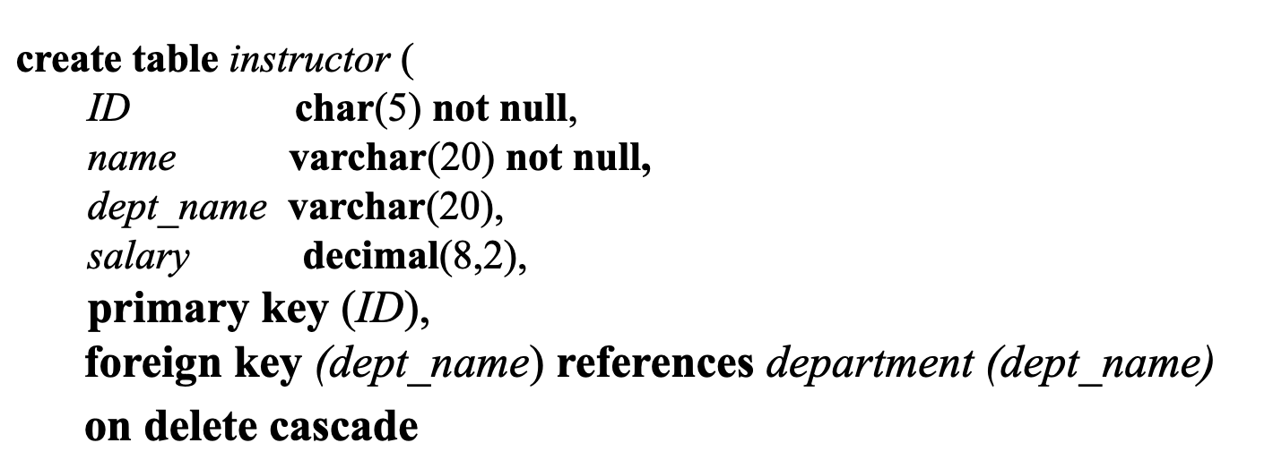
Foreign Keys – on delete cascade
on delete specifies what happens to the tuples in instructor if the referenced tuple is deleted.
cascade – the child tuple is deleted (so, if the associated department for an instructor is deleted, all instructors associated with that dept are also deleted

Slide 22
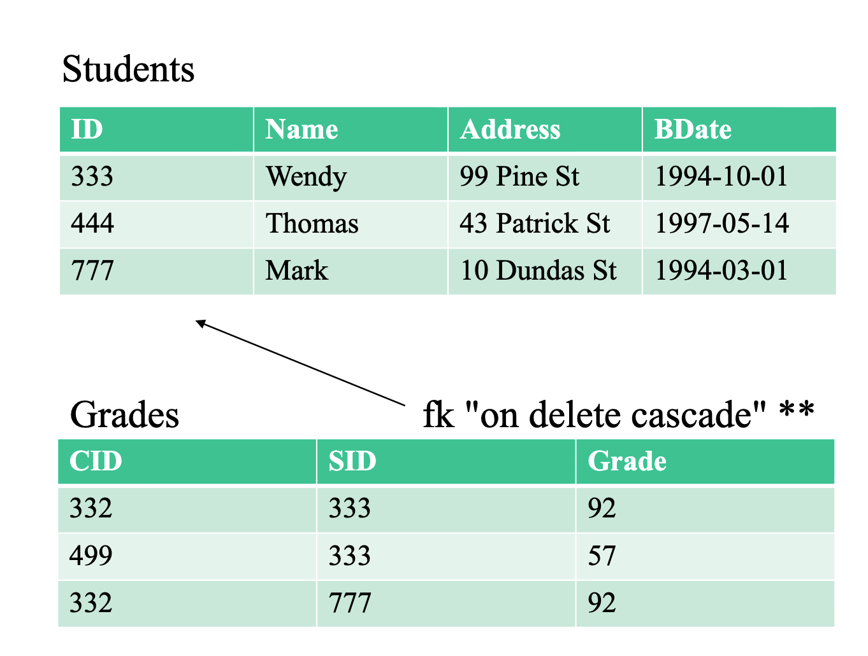
**eg. if student 333 is deleted from Students, all records for student 333 in grades are also deleted

Slide 23
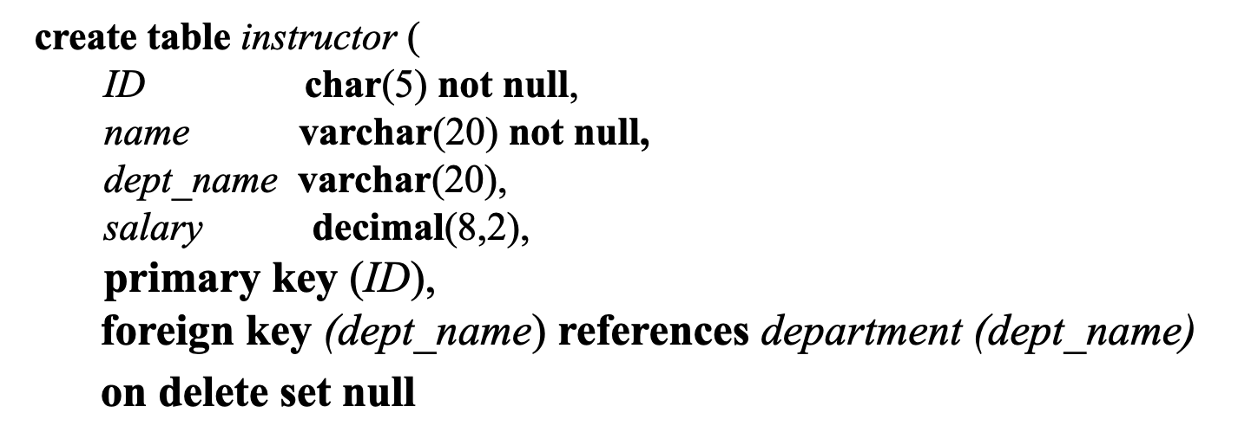
Foreign Keys – on delete set null
on delete specifies what happens to the tuples in instructor if the referenced tuple is deleted:
set null – the child tuple’s department value is set to null. So, if the department is deleted from the department table, the instructor remains, but has “null” for the department name

Slide 24
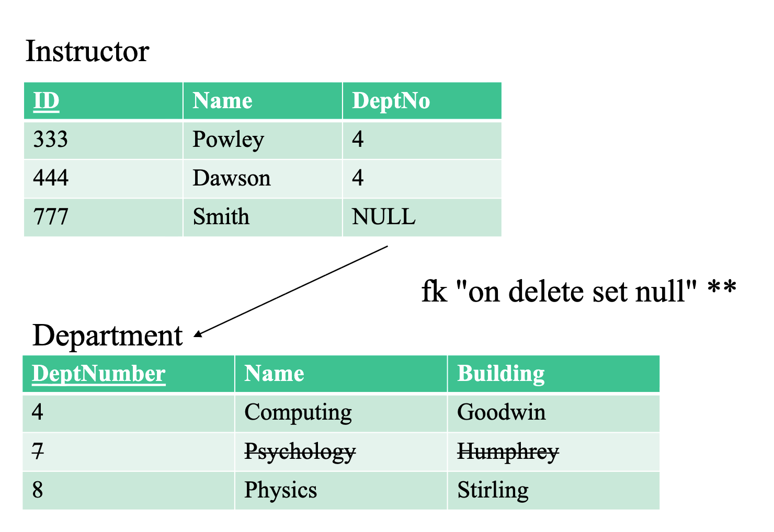
**eg. if a department is deleted, the Dept No will be set to NULL

Slide 25
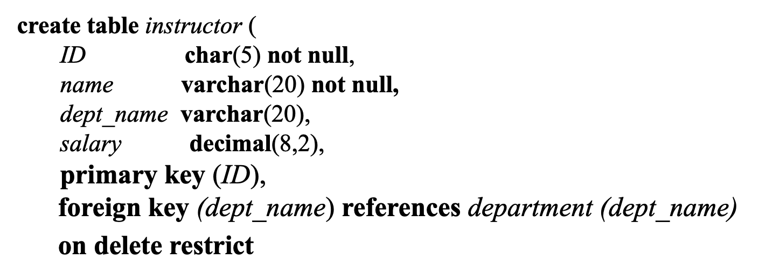
Foreign Keys – on delete restrict
on delete specifies what happens to the tuples in instructor if the referenced tuple is deleted:
restrict – the deletion of the department will be rejected if there are instructors that are associated with that department
This is the default if no constraint is specified.

Slide 26
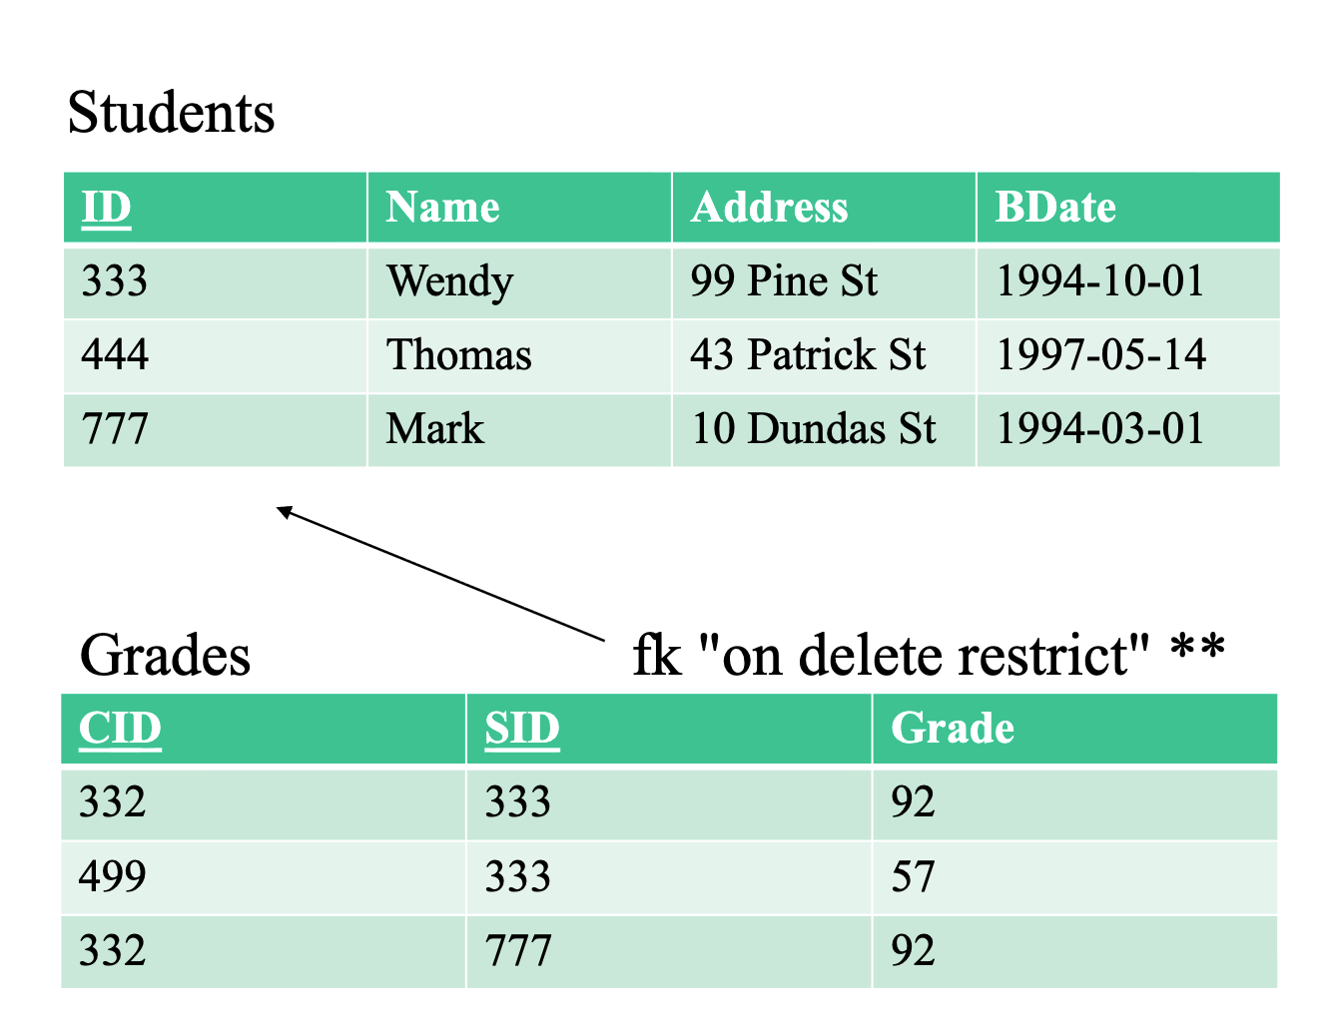
*eg Students 333 and 777 cannot be deleted from Students as there are rows referencing them in Grades.

Slide 27
Other Constraints
In addition to “on delete”, you can also specify the same types of actions for “on update”.
On update cascade:
if a department name is changed in the referenced table, it is also changed in the referencing table.

Slide 28
Defaults
if no constraint is specified for “on delete” or “on update”, any deletions or updates are rejected if there is a referencing tuple

Slide 29
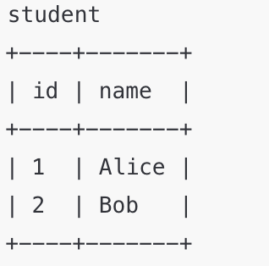
Drop and Alter Table Constructs
Drop table student
Before: student(id, name, dept)
After: ‘no longer exists)
Delete from student
Before:
After: empty table, but it’s still there

Slide 30
Alter Table Constructs
Alter table r ADD A D
Ex: ALTER TABLE student ADD email VARCHAR(50);
Before: student(id, name)
After: student(id, name, email)
Alter table r DROP A
Ex: ALTER TABLE student DROP email;
Before: student(id, name, email)
After: student(id, name)

Slide 31
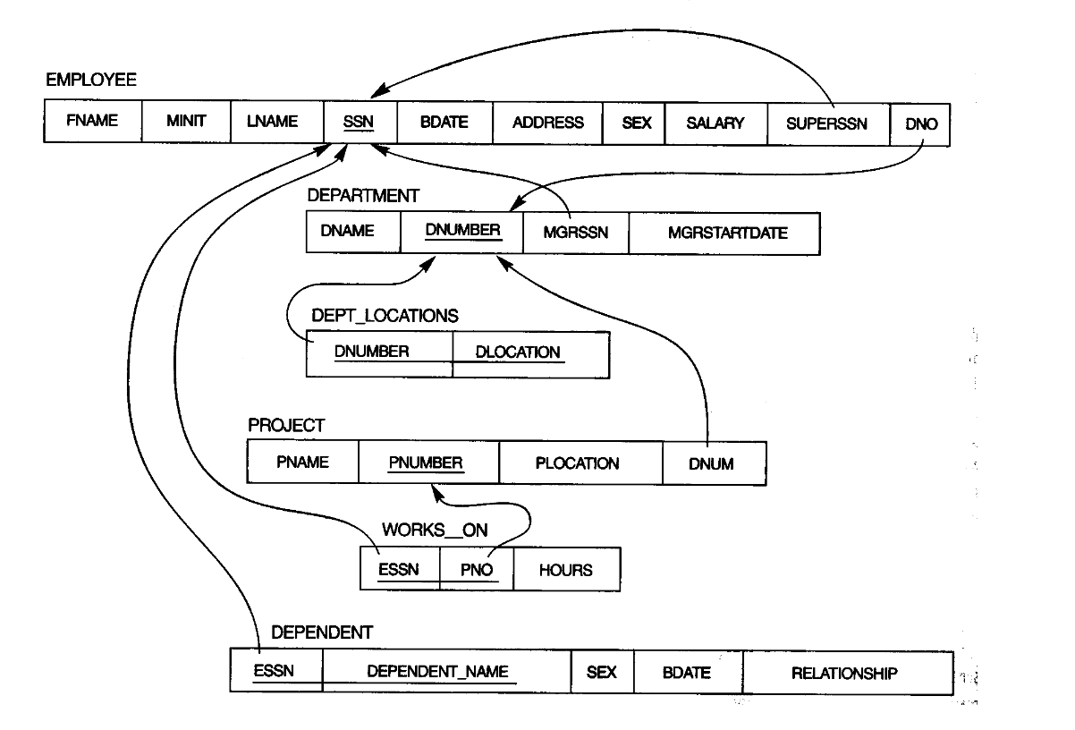
What’s next

Slide 32
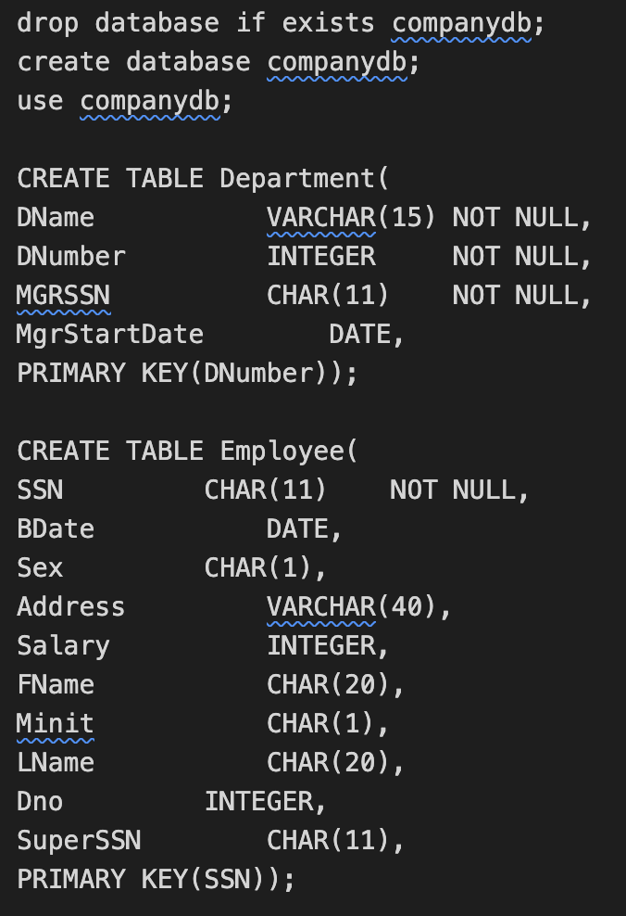
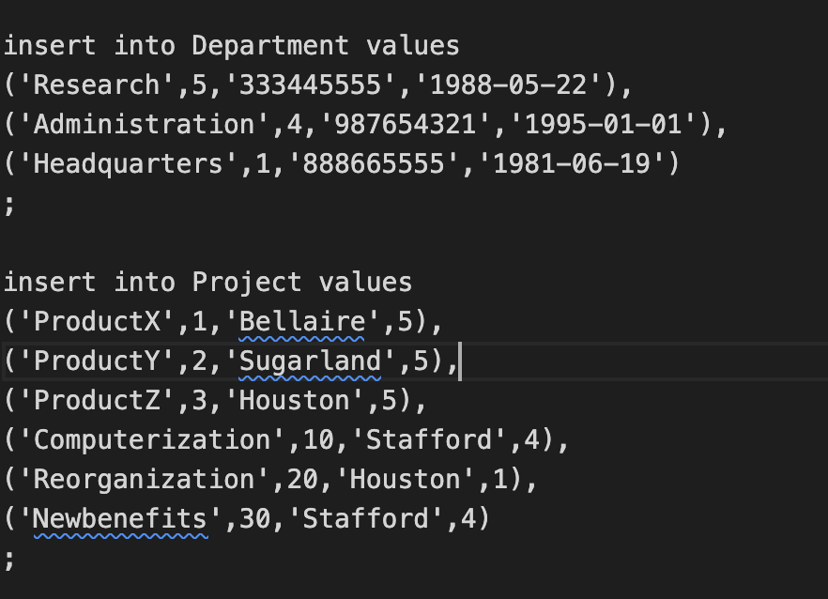
What’s next
SQL scripts
DO NOT COPY AND PASTE

